Slide 1
EMBODIED AI · WEEK 24
R1 motion retargeting
I took a research retargeting tool, added our robot to it — it did not support the R1 — and turned
35 seconds of human boxing into robot joint angles. Then I measured whether the result was
something a real machine could have done. It was not, and the way I found that out is the talk.
Shaoqin Li · Prof. Yi Sun · CCNY

Slide 2
What I set out to answer
Three questions, in the order I ran into them.
1
Can our robot use this at all?
Every retargeting paper I read targets the G1 or the H1. The tool everyone uses ships eleven
robots and the R1 is not one of them. So the first question was whether I could add it.
2
Does the motion look right?
A 35-second boxing capture, retargeted onto the R1, rendered as video — and put next to the
G1 running the identical capture, so I had something to compare against.
3
Could the robot actually have done it?
This is the one that matters. The video is convincing. That is not the same as possible, and
nothing in the pipeline ever checks.

Slide 3
The nine steps
Everything below runs on this laptop. No GPU is used at any point.
1
Made an environment and cloned the tool
20 min, nearly all download
2
Proved the R1 was missing
every format answered no
3
Added the R1 to the tool
a model, 43 shapes, two mapping files, five lines
4
Checked the install
one command, one verdict
5
Retargeted 35 seconds of boxing
faster than the motion plays
6
Watched it — and put it next to the G1
the part that looks finished
7
Opened the motion file
what a retargeted motion actually contains
8
Measured whether it was possible
the answer is no
9
Got the wrong answer on purpose
the mistake I made first, reproduced deliberately

Slide 4
THE PAPERS
What the field says about this
Two papers — the idea and what it refuses to do.
One is the tool I used. The other is the argument that the tool is not enough.

Slide 5
Retargeting Matters — the tool I used
Araújo, Ze, Xu, Wu, Liu (Stanford) · ICRA 2026 · open source, runs on a CPU
THE ARGUMENT
IN ONE SENTENCE
Everyone treats retargeting as plumbing — a preprocessing step you get through and stop
thinking about. This paper shows the plumbing is load-bearing. Feed a robot a reference full
of small impossibilities and whatever learns from it spends its capacity papering over them.
The failures show up worst on long and fast motions — exactly the ones worth having.
The reference motion is not preprocessing.
It is part of the method, and treating it
carelessly costs you performance later.
They release the tool, show it beats the other open-source options, and get close to the
expensive commercial motion data manufacturers keep to themselves.
THE CATCH, FOR US
Their headline experiment runs on a motion dataset that has no R1 mapping file. Nobody has written one.
So the benchmark in the paper that made this tool credible cannot currently be reproduced on our robot —
and writing that file is a small, unclaimed piece of work sitting in the open.

Slide 6
How it works, without the mathematics
Three ideas do all of it. I have deliberately left the equations out — none of them are the point.
A list of who drives whom
Somebody has to say: this human body part drives that robot body part. Left knee to left
knee, and so on. In this tool that is a plain text file — which is why adding a robot is
writing a file rather than writing code.
Weights, because you can't have everything
The robot's geometry will not let you put the hands, feet, hips and head all exactly where
the human's were. Each pairing carries a number saying how much it matters. Feet and torso
are heavy, wrists are light. The weights decide who loses.
Two passes over every frame
The first cares about the shape of the pose — the angle of the torso, the swing of a limb.
The second cares about where in the world that pose sits. Asking for both at once gives a
worse answer than asking for them in order.
The solver underneath is an existing open-source one. The contribution is the framing — and the fact that it runs
fast enough on an ordinary CPU to be used live rather than as an overnight batch job.

Slide 7
What retargeting is never asked
KDMR — Zhang, Haener, Madabushi, Tucker (Georgia Tech) · March 2026 · tested on the Unitree G1
Retargeting is a geometry problem: put the parts where the parts were. But walking is not a geometry problem.
Nothing in the tool knows about weight, contact or friction — so it will happily produce any of these, because
none of them are geometric errors. They are physics errors, and it was never asked about physics.
Floating
the sole never reaches the ground, because nothing said it had to
Ground penetration
the same error with the opposite sign — the floor is not in the problem
Foot sliding
planted, but drifting sideways. To a policy, an instruction to break friction
Impossible transitions
two poses each reachable, but not one after the other at that speed
The lost heel-to-toe roll
the foot treated as one rigid target, so the gait looks robotic
You cannot tune your way out of these by adjusting weights — the thing being optimised does not contain the physics at all.
KDMR adds a second stage that does. Its cost: it needs force plates. Doing the same check from the motion file alone is an open gap.

Slide 8
THE BUILD
Nine steps on one laptop
Every screen after this is output I actually got, not an illustration.
No GPU is used at any point. The whole thing runs on four CPU cores.

Slide 9
STEP 1 / 9
I made an environment and cloned the tool
It needs a specific simulator version and an IK library, and my other robot work needs different ones.
the whole install
conda create -n gmr python=3.10 -y
conda activate gmr
cd ~
git clone --recurse-submodules https://github.com/YanjieZe/GMR.git
cd GMR
pip install -e .
conda install -c conda-forge libstdcxx-ng -y
About twenty minutes, nearly all of it download — 3.6 GB with the robot assets.
AND ONE WARNING, FOREVER
xrobotoolkit_sdk not found, skip for now.
The submodule flag is not optional: without it you get a clone that imports fine and then
fails on a missing file.
It prints on every single command. It is a VR streaming dependency nothing here uses — not an error.

Slide 10
STEP 2 / 9
I proved the R1 was missing before adding anything
Each key is a motion-capture format. Each answer says whether a mapping exists for our robot.
$ python -c "from general_motion_retargeting import IK_CONFIG_DICT; \
print({k: 'unitree_r1' in v for k, v in IK_CONFIG_DICT.items()})"
{'smplx': False, 'bvh_lafan1': False, 'bvh_nokov': False, 'bvh_xsens': False,
'fbx': False, 'fbx_offline': False, 'xrobot': False, 'xsens_mvn': False}
That is a correct, fully working install of the tool — that cannot retarget onto our robot at all.
Eleven robots supported, several of them Unitree's. Not this one.
I ran this first on purpose. It is the before picture, and it is the reason the next step counts as work rather than as configuration.

Slide 11
STEP 3 / 9
I added the R1 — four things, and it prints all four
A model, its 43 shapes, two mapping files, and five lines registering the robot.
$ python install_r1_into_gmr.py --meshes support/assets
GMR clone: /home/sql/GMR
r1_mocap.xml -> assets/unitree_r1/r1_mocap.xml
r1_scene.xml -> assets/unitree_r1/r1_scene.xml
bvh_xsens_to_r1.json -> general_motion_retargeting/ik_configs/bvh_xsens_to_r1.json
smplx_to_r1.json -> general_motion_retargeting/ik_configs/smplx_to_r1.json
43 meshes copied from support/assets
params.py: 5 entries added (backup: params.py.before_r1)
R1 accepted from: smplx, bvh_xsens
OK -- the R1 is installed in GMR
Two formats now work: the format our capture is in, and the one the big public dataset uses. The third — the one most
tutorials use — still says no, because nobody has written that mapping for this robot.

Slide 12
STEP 4 / 9
I checked the install rather than assuming it
Nine things, one verdict. I wrote this so a failed install is found now and not mid-session.
$ python check_setup.py
[ok] python 3.10+ 3.10
[ok] mujoco 3.6.0
[ok] mink (the IK solver)
[ok] general_motion_retargeting
[ok] R1 robot model r1_scene.xml
[ok] R1 motion mappings smplx, bvh_xsens
[ok] the boxing capture 2949 KB
[ok] mujoco_menagerie submodule
[ok] video writer (imageio)
READY. Nothing else to install.
Anything that fails prints the exact command that fixes it.

Slide 13
STEP 5 / 9
I retargeted 35 seconds of boxing
The tool ships one motion capture: 4,249 frames at 120 Hz, recorded with a motion-capture suit.
$ python scripts/xsens_bvh_to_robot_headless.py \
--bvh_file assets/xsens_bvh_test/251021_04_boxing_120Hz_cm_3DsMax.bvh \
--robot unitree_r1 --start 600 --end 1800 --save_path out/mine.pkl
[headless] IK solve rate: 197.2 FPS (6.1s for 1200 frames),
motion is 120 fps -> real-time capable
[headless] motion saved to out/mine.pkl
IT SOLVES FASTER THAN THE MOTION PLAYS
WHY I SKIP THE FIRST 600 FRAMES
197 poses a second against a motion recorded at 120. So this is not an overnight batch job —
it could run live, off a suit somebody is wearing, with margin to spare.
Because they are not the boxing. Step 9 is me finding that out the hard way, on purpose,
in front of you.

Slide 14
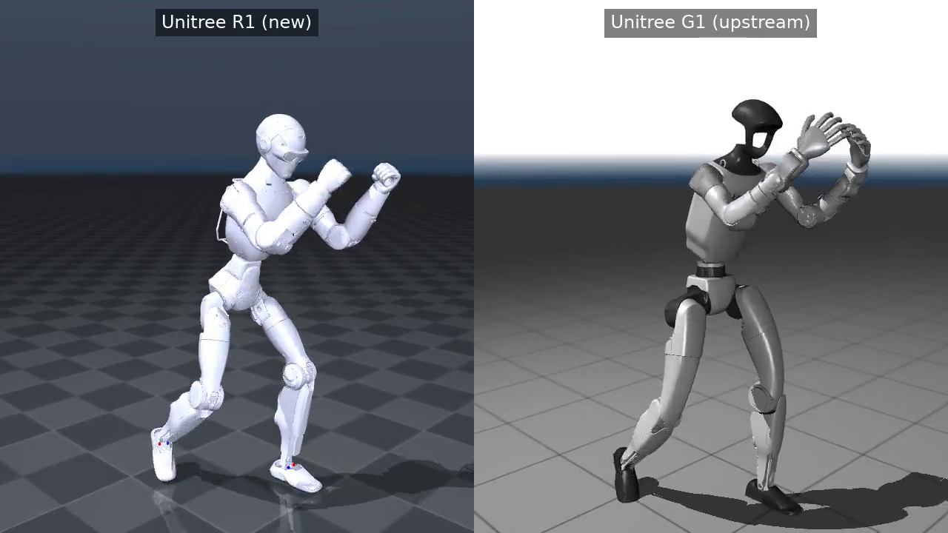
STEP 6 / 9
I watched it — and put it next to the G1
The G1 is the robot every paper uses. Running the identical capture on both is my control.
the same 35-second capture, retargeted onto both robots — R1 left, G1 right
Watch it and commit to a judgement before the next slide: does that look like a real robot boxing?

Slide 15
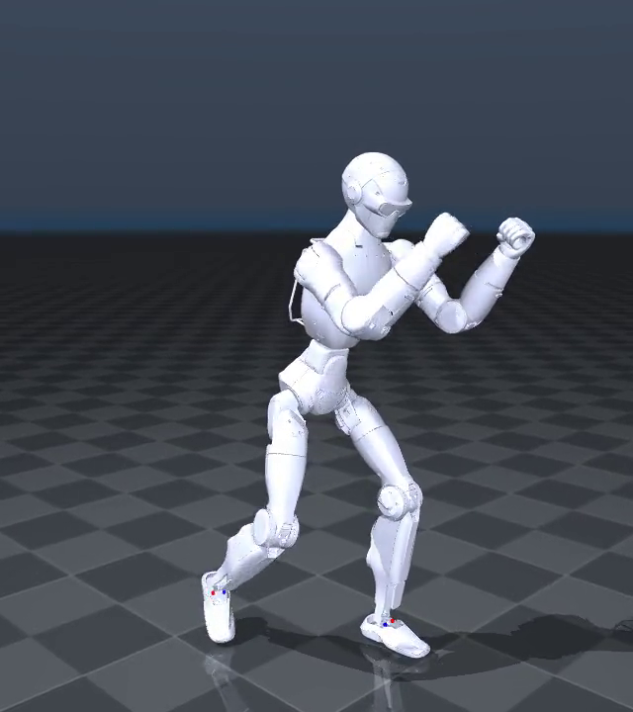
It is genuinely convincing
Which is the problem, and the reason the rest of this talk exists.
The guard comes up. The weight shifts between the feet. The punches extend and retract.
The feet stay planted under the body.
Nothing about it looks wrong — and I had no way to say whether it was right.
Everything I had built up to this point could tell me the poses were close to the human's.
None of it could tell me whether a machine with mass, motors and a floor could have
produced them.
So I wrote something that could.

Slide 16
STEP 7 / 9
I opened the motion file to see what I actually had
Before measuring it, I wanted to know what a retargeted motion contains.
root_pos (1200, 3) float64 where the pelvis is
root_rot (1200, 4) float64 which way it faces
dof_pos (1200, 24) float64 the angle of each of the 24 joints
fps () int64
robot () <U10
NOTICE WHAT IS NOT THERE
No velocities. No forces. No torques. No contact. No mass. Nothing about whether any of this is possible —
it is a list of poses and the times to hold them.
That absence is not a bug in the file format. It is the whole point: the tool was asked where the limbs go, and that is what it stored.

Slide 17
STEP 8 / 9
I measured whether the robot could have done it
Four questions a real machine would have to satisfy. I wrote the tool; it takes a motion file and answers them.
$ python exp4_check_motion.py out/mine.pkl
1. FEET -- does the robot ever touch the ground?
lowest contact point: min -1.15 cm mean +0.50 cm max +1.80 cm
-> touches down on 762/1200 frames (64%)
2. PELVIS -- does the body rise and fall like a real one?
height 0.648 .. 0.733 m (range 8.49 cm)
-> moves, as a real body would
3. LIMITS -- is any joint pushed past its mechanical stop?
-> none. every joint stays inside its range.
4. SPEED -- could a motor actually move this fast?
peak joint speed 27.3 rad/s (limit set to 20)
-> exceeded on 5 frames
VERDICT
NOT physically
realisable
the feet go through the floor,
and five frames need a motor
faster than the servo is
TWO OF FOUR PASS
The body rises and falls 8.5 cm,
like a real one, and no joint is
driven past its stop.
Whoever built this did not do it
carelessly — it fails anyway.

Slide 18
STEP 9 / 9
Then I got a much better wrong answer, on purpose
I retargeted the first three seconds instead — the part I had told myself to skip.
1. FEET -- does the robot ever touch the ground?
lowest contact point: min +4.53 cm mean +4.58 cm max +4.63 cm
-> FLOATING the whole time. 0 of 360 frames make contact.
2. PELVIS -- does the body rise and fall like a real one?
height 0.787 .. 0.787 m (range 0.06 cm)
-> FROZEN. A moving human does not hold this constant.
4. SPEED -- could a motor actually move this fast?
peak joint speed 0.6 rad/s
!! WARNING -- THIS LOOKS LIKE A CALIBRATION POSE, NOT A MOTION.
A FAR BETTER STORY
“The robot never touches the
ground and its pelvis never
moves.”
AND COMPLETELY WRONG
Every capture opens with the
performer standing still for
calibration. I measured that,
not the boxing.
The giveaway was check 4 — the one I was not even looking at. 0.6 rad/s is impossibly slow for someone throwing punches.
I reported this as a finding before I caught it. The tool now refuses to give a verdict when the input looks like a calibration pose.

Slide 19
The measurement that disagreed with itself
Same source file, same tool, same robot — retargeted twice, over different frame ranges.
ALL 4,249 FRAMES, ONE RUN
FRAMES 600–1800, ON THEIR OWN
floats +3.22 … +5.57 cm
0 of 4249 frames touch the ground
penetrates −1.15 cm
762 of 1200 frames in contact
what I reported in July
what I reported last week
so I compared the same frames from both runs
$ python compare_windows.py --full out/full_capture.pkl --window out/mine.pkl
root height difference (full - windowed):
mean +0.0590 m sd 0.004326 m min +0.0512 max +0.0642
joint angles, same frames: max |difference| = 5.053e-01 rad
The robot sits 5.9 cm higher in one run than the other — and the joint angles differ by half a radian, so it is not just a shift.
The tool works out where the floor is from the clip you hand it, and it solves each frame starting from the previous one. Change the
clip and you change both. Both of my numbers were honest measurements of two genuinely different outputs.

Slide 20
What I found
Three things, and the third one is new since last week.
The R1 works in this tool now, and it did not before
Two capture formats accepted, a 35-second motion retargeted, and a control run on the G1 to compare
against. As far as I can find, there is no published work using this robot at all.
The motion looks finished and is not physically possible
The feet go through the floor by just over a centimetre, and five frames ask a joint to move faster
than the servo can. Nothing in the pipeline was ever asked about gravity, contact or torque.
Two of my own measurements disagreed — and both were right
That is the next slide. It is the most interesting thing I have found in this line of work.

Slide 21
What I had to correct along the way
Three, and I would rather say them than have them asked.
What I added is smaller than it sounds
The R1 mapping file is the G1's with two changes: one wrist joint renamed, and three limb-size numbers
retuned. Every body pairing and every weight is the tool's, unchanged. It is adapting, not deriving.
Those three numbers were tuned by hand, not calculated
I measured the robot's bones against the performer's afterwards. The geometry implies 0.67 and 0.70;
the file says 0.818 and 0.578. They were arrived at by trying values until the motion looked right.
None of this is committed anywhere
It lives as loose files inside a clone of somebody else's repository — a repository that is now a
published paper. Getting it upstreamed would make it citable and would take an afternoon.

Slide 22
WHERE THIS GOES NEXT
Four things, in the order I would do them
1
Find out which of the two causes drives the disagreement
Turn off the floor inference, re-run, and see how much of the 5.9 cm survives. Half a day, no new hardware.
2
Set the three size numbers from the measured bones
Then re-run the measurement and see whether the feet stop going through the floor. Ten minutes, a result either way.
3
Write the missing mapping file for the big public dataset
It would open that dataset to this robot — and make the benchmark in the tool's own paper reproducible here.
4
Check the motion with physics, not just geometry
The second paper does this but needs force plates. Doing it from the motion file alone is the gap it leaves open.
And the thing that makes any of it worth writing up: as of this week, an arXiv search for "Unitree R1" returns nothing at all.

